Slide 1
Sequential System
Combinational system
  The output at any instant of time depends only on what the inputs are at that time.
    Small delay is ignored.
Sequential system (finite state machine)
  The output depends not only on the present inputs but also on the past history (memory).
    What has happened earlier.

Slide 2
SEQUENTIAL CIRCUITS
General Model of Sequential Circuit
Flip-Flop as Basic Memory Unit
Analysis of Sequential Circuits
Design of Sequential Circuits
Sequential MSI Modules

Slide 3
Synchronous Sequential System
Inputs
Combinational Logic
Outputs
Present
state
Next
state
Memory
Clock
Combinational logic is a function of the system inputs and the contents of the memory.
Outputs of combinational logic are the system outputs and signals to update the memory.
The state changes only at discrete instants of time, typically synchronous to the clock signal.

Slide 4
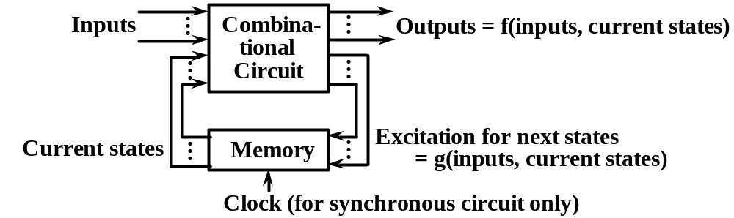
General Model of Sequential Circuit
Output depends on circuit’s history stored as state
variables in memory.
Mealy machine: outputs = f(inputs,current states)
Moore machine: outputs = f(current states)
It has no input variables other than the clock.
Excitation signals act on memory for next states.

Slide 5
Clocked System
Clocked System (synchronous system)
  A clock is a signal that alternates (over time) between 0 and 1 at a regular rate.
  T (on the diagram) is the length of one cycle.
  Frequency is the inverse (1/T). (1 Hz is 1 cycle per second)
    T = 5 nsec = 5 nanoseconds = 5*10⁻⁹ second
    F = 1/T = 1/(5*10⁻⁹) = 200*10⁶ Hz = 200 MHz (megahertz)
T

Slide 6
Types of Binary Storage Devices
Latch
  Static device, no clock involved.
  Output changes immediately whenever the input changes.
  Used for temporary (buffer) storage.
Flip flop
  Clocked device.
  Output changes shortly after a clock transition
  (at the edge of the clock).
  Two outputs Q and Q’
  (bit stored and its complement).

Slide 7
SR Latch
A latch is a binary storage device with feedback -- the output of each gate is connected to the input of the other gate.
P = (S+Q)’
Q = (R+P)’
S=1, R=0 -- 1 is stored in Q -- S (set)
P = (1+Q)’ = 1’ = 0
Q = (0+0)’ = 0’ = 1
S=0, R=1 -- 0 is stored in Q -- R (reset)
Q = (1+P)’ = 1’ = 0
P = (0+0)’ = 0’ = 1
S=R=0 -- normal storage state
P = Q’ (Therefore, P is labeled as Q’)
Q = P’
S=R=1 -- undefined
Unpredictable next state (race condition) when S=R=0
S
•
P
(Q’)
•
Q
R
S | R | Q | Q’
1 | 0 | 1 | 0 | Set
0 | 0 | 1 | 0
0 | 1 | 0 | 1 | Reset
0 | 0 | 0 | 1
1 | 1 | 0 | 0 | Undefined

Slide 8
Waveform of SR Latch
S
R
Q
Q’
Set
Reset
Set
Reset
Race
Hold
Forbidden
Hold
Forbidden

Slide 9
Flip Flop
A flip flop is a clocked binary storage device.
  The state will only change on the transition of the clock.
    Trailing-edge triggered -- change takes place when the clock goes from 1 to 0.
    Leading-edge triggered -- change takes place when the clock goes from 0 to 1.
Four types of flip flop
  D, SR, T, and JK flip flop

Slide 10
SR Master/Slave Flip Flop
S
•
•
Q
X’
•
•
•
X
•
Q’
R
Clock
•
Master
Slave
When the clock is 1, the first flip flop (master) is enabled.
When the clock is 0, the second flip flop (slave) is enabled.
It is trailing-edge triggered.

Slide 11
SR (Set-Reset) Flip Flop
10
S
Q
S
Q
00
01
00
10
0
SR
1
R
Q’
R
Q’
01
Clock
Clock
SR
q
00
01
11
10
S | R | Q(t) | Q(q+1)
0 | 0 | 0 | 0
0 | 0 | 1 | 1
0 | 1 | 0 | 0
0 | 1 | 1 | 0
1 | 0 | 0 | 1
1 | 0 | 1 | 1
1 | 1 | 0 | --
1 | 1 | 1 | --
S | R | Q(t+1)
0 | 0 | q
0 | 1 | 0
1 | 0 | 1
1 | 1 | --
0
X
1
1
1
X
1
not allowed
Q(t+1) = S + R’Q(t)
not allowed

Slide 12
Timing Diagram of SR Flip Flop
Clock
CLR’
S
R
Q

Slide 13
D Flip Flop
The output is just the input delayed until the next active clock transition.
The triangle is used to indicate which input is the clock.
A circle is shown on the clock input of a trailing-edge triggered flip flop.
Q
Q
D
D
Q’
Q’
Clock
Clock
Trailing-edge triggered
Leading-edge triggered
D | Q(t) | Q(t+1)
0 | 0 | 0
0 | 1 | 0
1 | 0 | 1
1 | 1 | 1
D | Q(t+1)
0 | 0
1 | 1
1
0
0
D
1
1
Q(t+1) = D
0

Slide 14
Trailing-Edge Triggered D Flip Flop
Clock
D
Q
Q’
Value Q changes shortly after the trailing edge of the clock.
Slashed sections indicate the unknown initial values of Q and Q’.
D should reach the correct value before the next active clock transition.

Slide 15
Leading-Edge Triggered D Flip Flop
Clock
D
Q
Q’
Value Q changes shortly after the leading edge of the clock.

Slide 16
JK Flip Flop
10
11
J
q
J
q
q’
K
q’
00
01
00
10
K
0
JK
1
01
11
Clock
Clock
J | K | q | q*
0 | 0 | 0 | 0
0 | 0 | 1 | 1
0 | 1 | 0 | 0
0 | 1 | 1 | 0
1 | 0 | 0 | 1
1 | 0 | 1 | 1
1 | 1 | 0 | 1
1 | 1 | 1 | 0
J | K | q*
0 | 0 | q
0 | 1 | 0
1 | 0 | 1
1 | 1 | q’
JK
q
00
01
11
10
0
1
1
1
1
1
JK flip flop is a combination of the SR and T.
q* = Jq’ + K’q

Slide 17
Timing Diagram of JK Flip Flop
Clock
CLR’
J
K
q

Slide 18
T (Toggle) Flip Flop
q
q
T | Q(t) | Q(t+1)
0 | 0 | 0
0 | 1 | 1
1 | 0 | 1
1 | 1 | 0
T | Q(t+1)
0 | q
1 | q’
Q(t+1) = T⊕ Q(t)
T
T
q’
q’
1
Clock
Clock
0
0
T
1
0
1
Clock
CLR’
T
q

Slide 19
Two Flip Flops
q
r
The output of flip flop r is a replica of that of q, delayed by one clock period.
x
D
D
q’
r’
•
Clock
Clock
D
q
r

Slide 20
Basic Idea of Pipelining
q
q
q
q
D
q’
D
q’
D
q’
D
q’
q
q
q
q
D
q’
D
q’
D
q’
D
q’
q
q
q
q
D
q’
1
D
q’
2
D
q’
D
q’
•
•
•
•
Clock
stands for combinational logic.
A group of flip flops store the outputs of combinational logic of the current stage. Clock synchronizes all flip flops.

Slide 21
Flip Flop with Clear & Preset Inputs
D
PRE
Q
PRE’ | CLR’ | D | Q(t) | Q(t+1)
0 | 1 | X | X | 1
1 | 0 | X | X | 0
0 | 0 | X | X | --
1 | 1 | 0 | 0 | 0
1 | 1 | 0 | 1 | 0
1 | 1 | 1 | 0 | 1
1 | 1 | 1 | 1 | 1
Clock
Q’
static
immediate
CLR
not allowed
clocked
D
PRE’
Q
Clock
Q’
CLR’

Slide 22
Timing for Flip Flop with Clear & Preset
Clock
CLR’
PRE’
D
Q

Slide 23
Implementation of SR Flip Flop
S
•
•
Q
•
•
•
•
Q’
R
Clock
•

Slide 24
Implementation of D Flip Flop
D
•
•
•
Q
•
•
•
•
Q’
Clock
•

Slide 25
Implementation of JK Flip Flop
J
•
•
Q
•
•
•
•
•
•
Q’
K
Clock
•

Slide 26
Implementation of T Flip Flop
T
•
•
•
Q
•
•
•
•
•
•
Q’
Clock
•
q* = T⊕ q = Tq’+T’q = Jq’ + K’q

